Slide 1


Tourism and Sri Lanka
Ways to grow tourism in our island nation

Slide 2

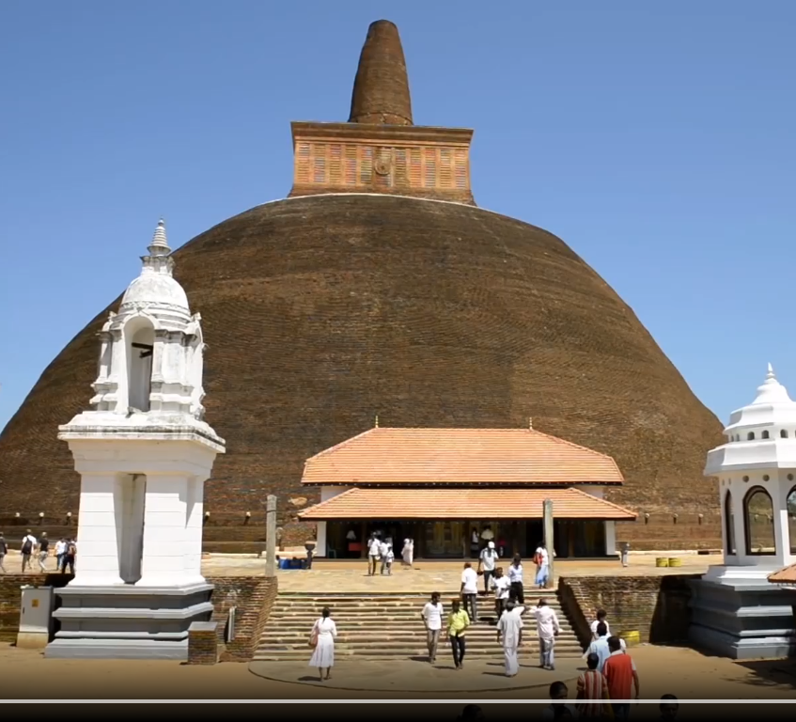



Cultural Tourism
Increase focus on cultural past.
Renovating airports to reflect Sri Lankan heritage.
Construction of traditional resorts in major tourist attractions rather than Western representation of resorts.

Slide 3
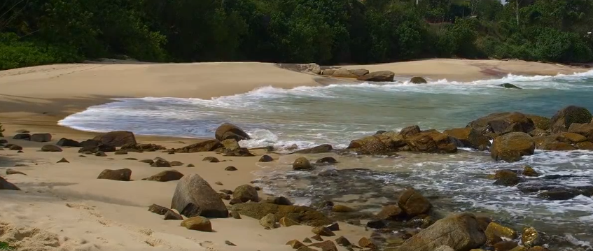
Keep SL Clean
The cleanliness of SL should be maintained, through 3R (Reuse, Reduce, and Recycle) campaigns.
There should be education on how to keep the country clean.

Slide 4
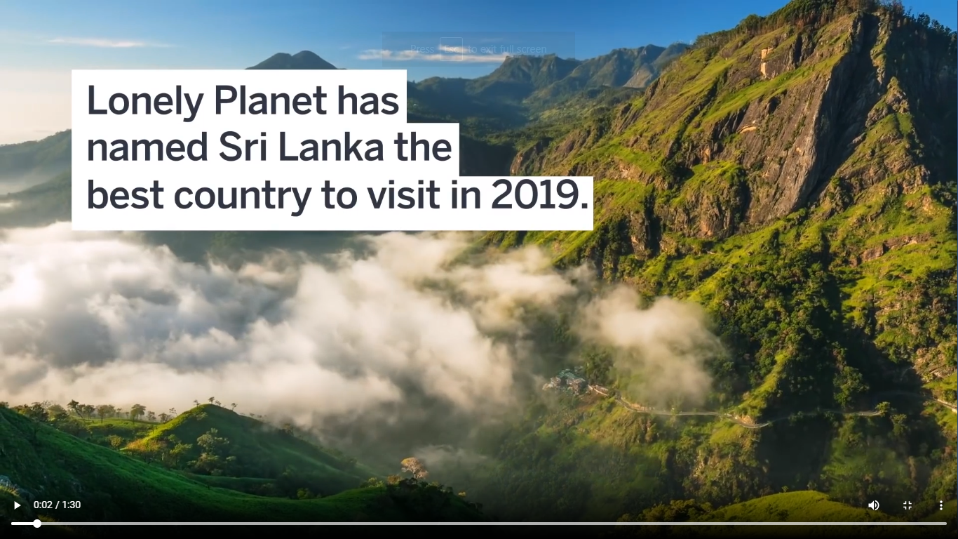
Promotional Campaigns
SL and its many attractions are not known by that many around the world.
Promoting Sri Lanka, such as through tourist guides like Lonely Planet, and innovative social media platforms, should be maintained.
This would ensure false images of the nation would not be held in the minds of tourists.

Slide 5
Transport Links
Sri Lanka, even though it may be small, needs to have better transport links.
Islandwide luxury coach systems to popular tourists destinations have to be provided.
Train systems should be revamped.
Roads have to be developed.

Slide 6
Security
Improving knowledge for tourists through innovative briefings for tourists making them aware of help lines for emergencies.
Making it mandatory for guides to have achieved a very thorough understanding of security procedures and how to handle them effectively.

